Slide 1

Predicting Movie Ratings with Machine Learning
Harnessing Data to Forecast Cinematic Success
Team Members: Team Members: Ghatar butti alqhtani, , Abdullah Saad Al-QarniCourse: [Machine Learning] Project Supervision: Dr. [Ali Falih Al-Shahrani]

Slide 2

The Challenge of Predicting Movie Success
The Challenge: Predicting movie ratings is complex, influenced by factors beyond box office success.
Our Goal: To leverage Machine Learning (Regression) to accurately forecast audience reception and provide data-driven insights into cinematic success.

Slide 3




Data Collection: The TMDB 5000 Dataset
Kaggle Source
Scale & Scope
Source: TMDB 5000 Movie Dataset from Kaggle
Scale: Over 5,000 movies. Scope: Regression problem (Rating Prediction).
Key Features
Target Variable: 'vote_average' (Movie Rating). Features: Budget, Revenue, Genres, Keywords, Cast, Crew

Slide 4
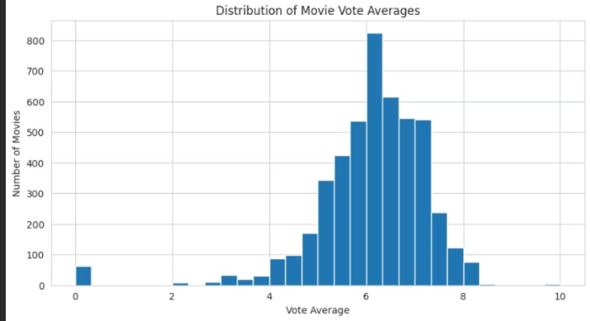
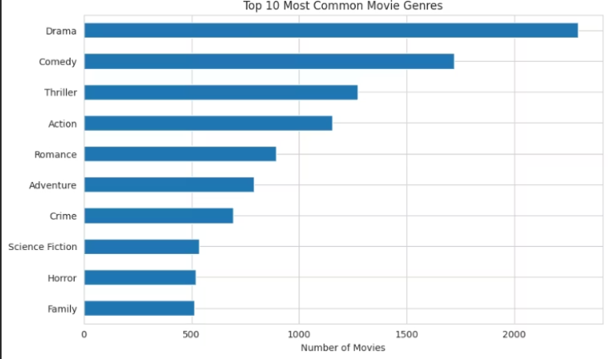
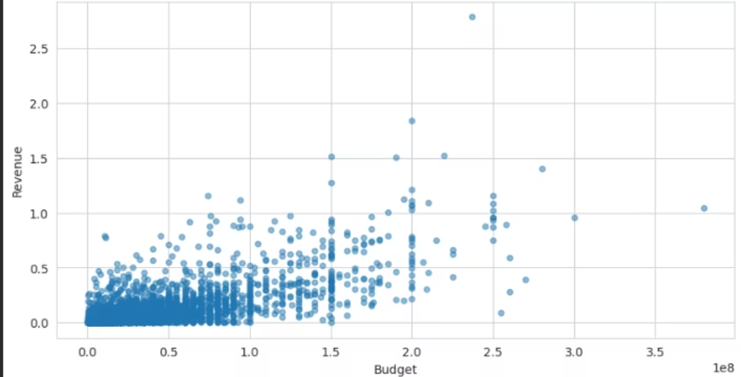
Exploratory Data Analysis: Unveiling Trends
Our EDA revealed interesting patterns in movie data, crucial for feature engineering and model selection.
Rating Distribution
Top Genres
Most movies fall within the 4-8 rating range, indicating a bell-curve distribution with fewer extremely high or low-rated films.
Drama and Comedy consistently emerge as the most prevalent genres, highlighting their enduring popularity among filmmakers and audiences.
Budget vs. Revenue Correlation
A positive correlation was observed between movie budget and revenue, suggesting higher investments often lead to greater financial returns, though with notable exceptions.

Slide 5

Data Preprocessing: Refining Raw Data
01
Handling Missing Values
We addressed incomplete entries by either imputing or dropping rows with significant missing data, ensuring data integrity.
02
JSON Feature Parsing
Complex JSON strings for genres, keywords, cast, and crew were parsed to extract meaningful categories and names.
03
Creating the 'Tags' Feature
A unified 'tags' column was engineered by concatenating cleaned genres, keywords, cast, and crew names, serving as a rich text-based feature for our models.
04
Text Normalization
Text Normalization: All text data within the 'tags' was converted to lowercase and tokenized (using CountVectorizer) to reduce dimensionality and improve consistency.

Slide 6
Model Building & Training
1. Feature Vectorization: Used CountVectorizer to convert the 'tags' text feature into a numerical matrix (5000 features).
2. Data Splitting: Split the dataset into 80% Training and 20% Testing sets for unbiased evaluation.
3. Models Trained (Regression): Linear Regression, Random Forest Regressor, XGBoost Regressor.

Slide 7
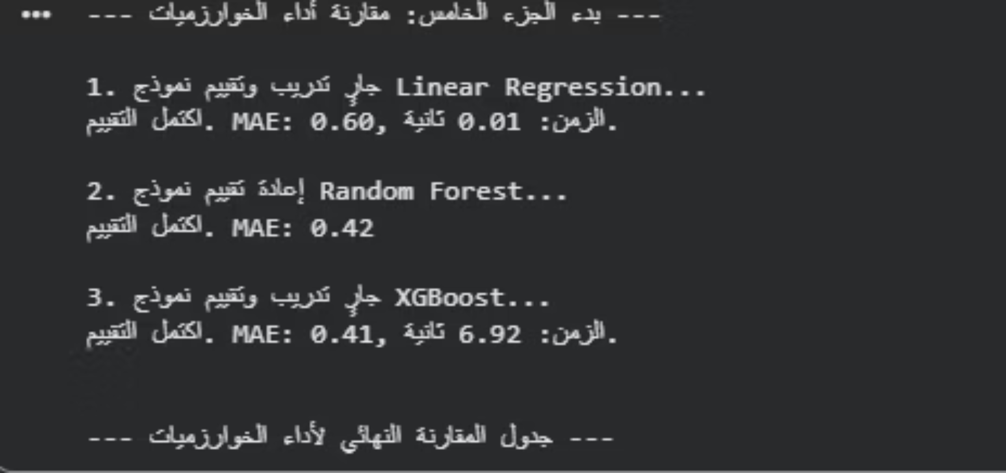
Results: Model Performance Comparison
After training and evaluating multiple models, XGBoost emerged as the superior performer in predicting movie ratings.
XGBoost: The Top Performer
XGBoost consistently delivered the lowest Mean Absolute Error (MAE)

Slide 8

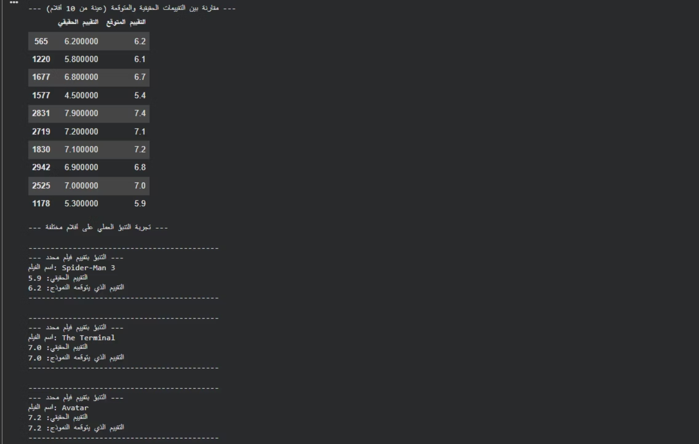
Live Prediction Examples
Our trained model can predict ratings for specific movies based on their attributes

Slide 9




Conclusion & Future Work
Project Summary
We successfully built a robust ML pipeline. XGBoost was the top performer, achieving an MAE of 0.41 in movie rating prediction.
Challenges Faced
Challenges focused on handling sparse text features (CountVectorizer) and fine-tuning model parameters for optimal results.
Future Enhancements
Integrating external data (e.g., social media sentiment) and developing a user-friendly prediction interface.

Slide 10

Questions & Discussion
Thank you for your attention!
Feel free to ask any questions about our methodology, results.

